Slide 1
Beyond Pull Requests: How Non-Code Contributions Scale Open-Source Projects
Sakshi Nasha, Kris Freedain

Slide 2
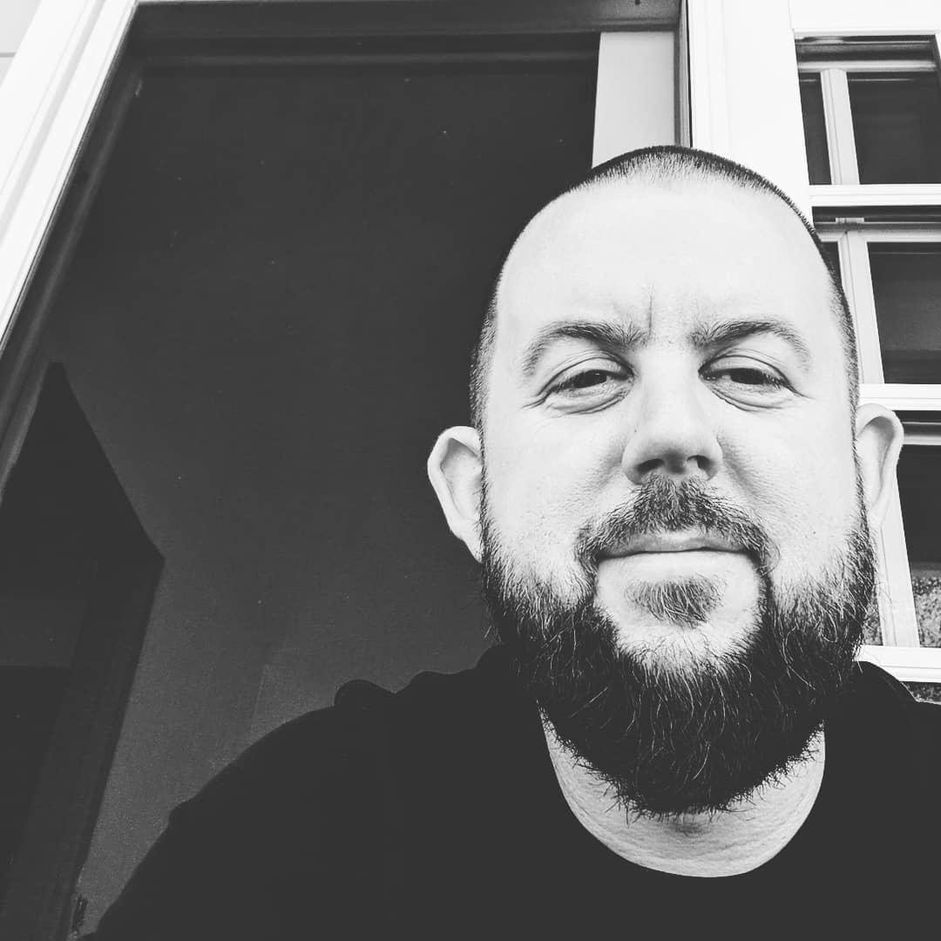







About Us
Kris Freedain (he/him)
Senior Community Manager (AWS)
OpenSearch Project
OpenSearch Software Foundation
Joined the project - Oct 2021
krisfreedain
Sakshi Nasha (she/her)
Software Engineer @Cohesity
OpenSearch Ambassador & Contributor
🗣️ 25+ International talks
🏸 🧗🏻‍♀️ ✈️
sakshi-nasha
Notes:
My name is Sakshi Nasha, I am a Software Engineer at Cohesity, I am an OS Ambassador and a Contributor. I am also an AWS community Builder I have over 25+ international talks you can scan the QR and get a list of all my talks and the recordings. Apart from work, I like to travel around the world, explore diff culture and play badminton

Slide 3
“I want to contribute to open source…
but I’m not good enough to write code.”
Notes:
This is the exact phrase we hear from thousands of brilliant engineers, tech writers, and students who feel locked out of open source. There is a massive misconception that the only way to be a "real" open-source contributor is to have your name on a massive feature pull request. Today, we’re going to bust that myth wide open.

Slide 4
Most open source projects don’t struggle because of lack of code.
They struggle because of lack of community.
Notes:
Think about it. Github is flooded with technically perfect repositories that are completely dead. Why? Because they don't have people managing issues, updating outdated documentation, or answering user questions. Code keeps a project functional, but community keeps it alive. Non-code contributors are the operational glue holding these scaling projects together.

Slide 5
What Stops Beginners?
FEAR | REALITY
“I’m not expert enough” | Maintainers need fresh eyes
“I can’t code at that level” | Docs/testing are critical
“I’m worried what others will think” | OSS is collaborative
“I don’t know where to start” | You just need curiosity Good first issues exist
Notes:
Slide to be considered for Apache 40 min talk

Slide 6
What REALLY Powers Open Source
Feature development
1
Reviews
RFC discussions
Samples
Blogs
2
Questions
Documentation
Testing
Bug reports
Community support Sharing knowledge
3
Notes:
The Pyramid Base: Look at the foundation here. At the bottom, we have the real engine of open-source innovation: the community. It’s the people answering questions, writing docs, reporting bugs, and sharing knowledge. Without this layer, nothing else scales.
The Middle Layer: Moving up, we see active engagement. This means jumping into RFC discussions to shape technical direction, giving critical feedback on code reviews, or creating POC samples to validate a feature.
The Top Layer: Only at the very peak do we find traditional feature development and bug fixes.
The Takeaway: Code is just one tiny layer of a much larger ecosystem. You don't have to build the peak to sustain the foundation.

Slide 7
Types of Contributions
01
Documentation
Blogs
README fixes
02
Request for Comments RFC
Proposal for discussion
Participate in Design discussion
03
META
Experiment
Improves project structure/process/docs
CI/CD & Automation
04
Blogs & Talks
Participate in forums & Slack: Community reply
Panelist for Event Proposals
Community & Advocacy
05
Testing and Bug Reports
Testing the new features
Reporting bugs when experimenting with the platform
Issue reproduction
Notes:
As you can see from these pathways : ranging from Documentation and RFC design discussions to META process updates, community advocacy, and robust issue reproduction, there are many doors into open source. You can heavily influence project architecture, improve automation pipelines, and drive business strategies through RFCs without ever writing a single line of production implementation code.

Slide 8
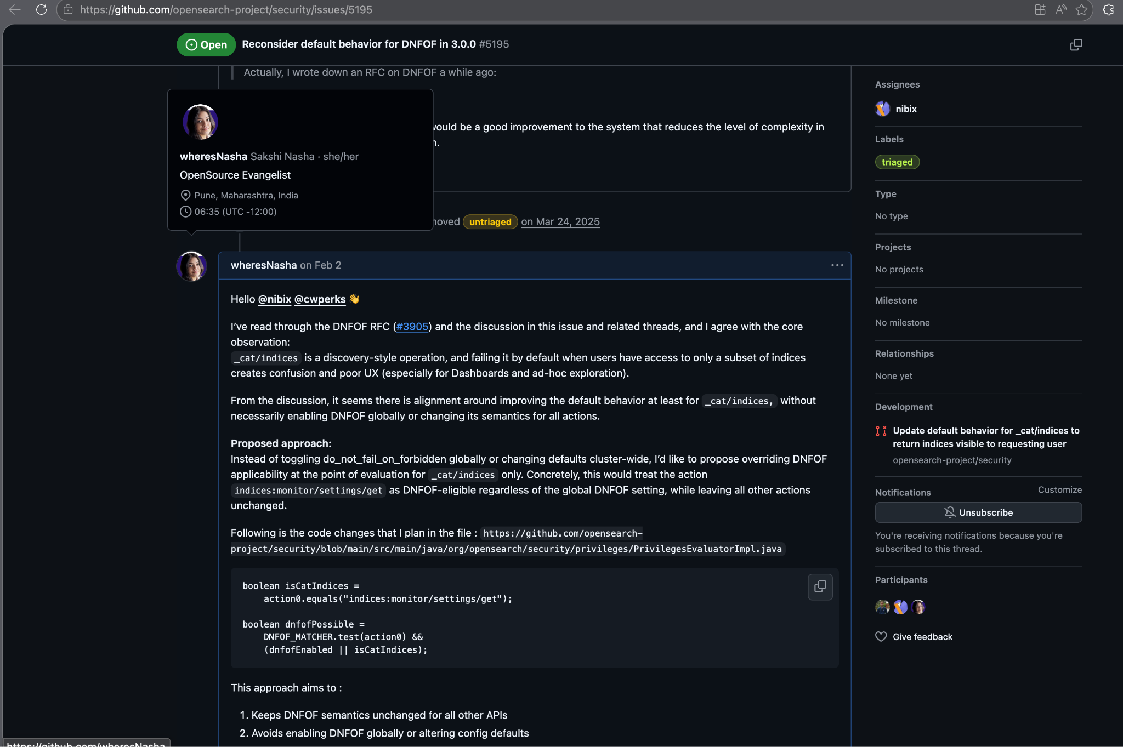

My first Design Discussion (RFC)
Notes:
Some of my beyond the PR contributions are My first RFC view in the security repository for reconsidering the default behavior of a Do not Fail on forbidden flag in OS 3.0.0. I added what my understanding is from the proposed design and then add my views/approach. Also, I added few questions that I had when we pick the proposed approach, covering different edge cases and what is the roadmap and long term implication.

Slide 9
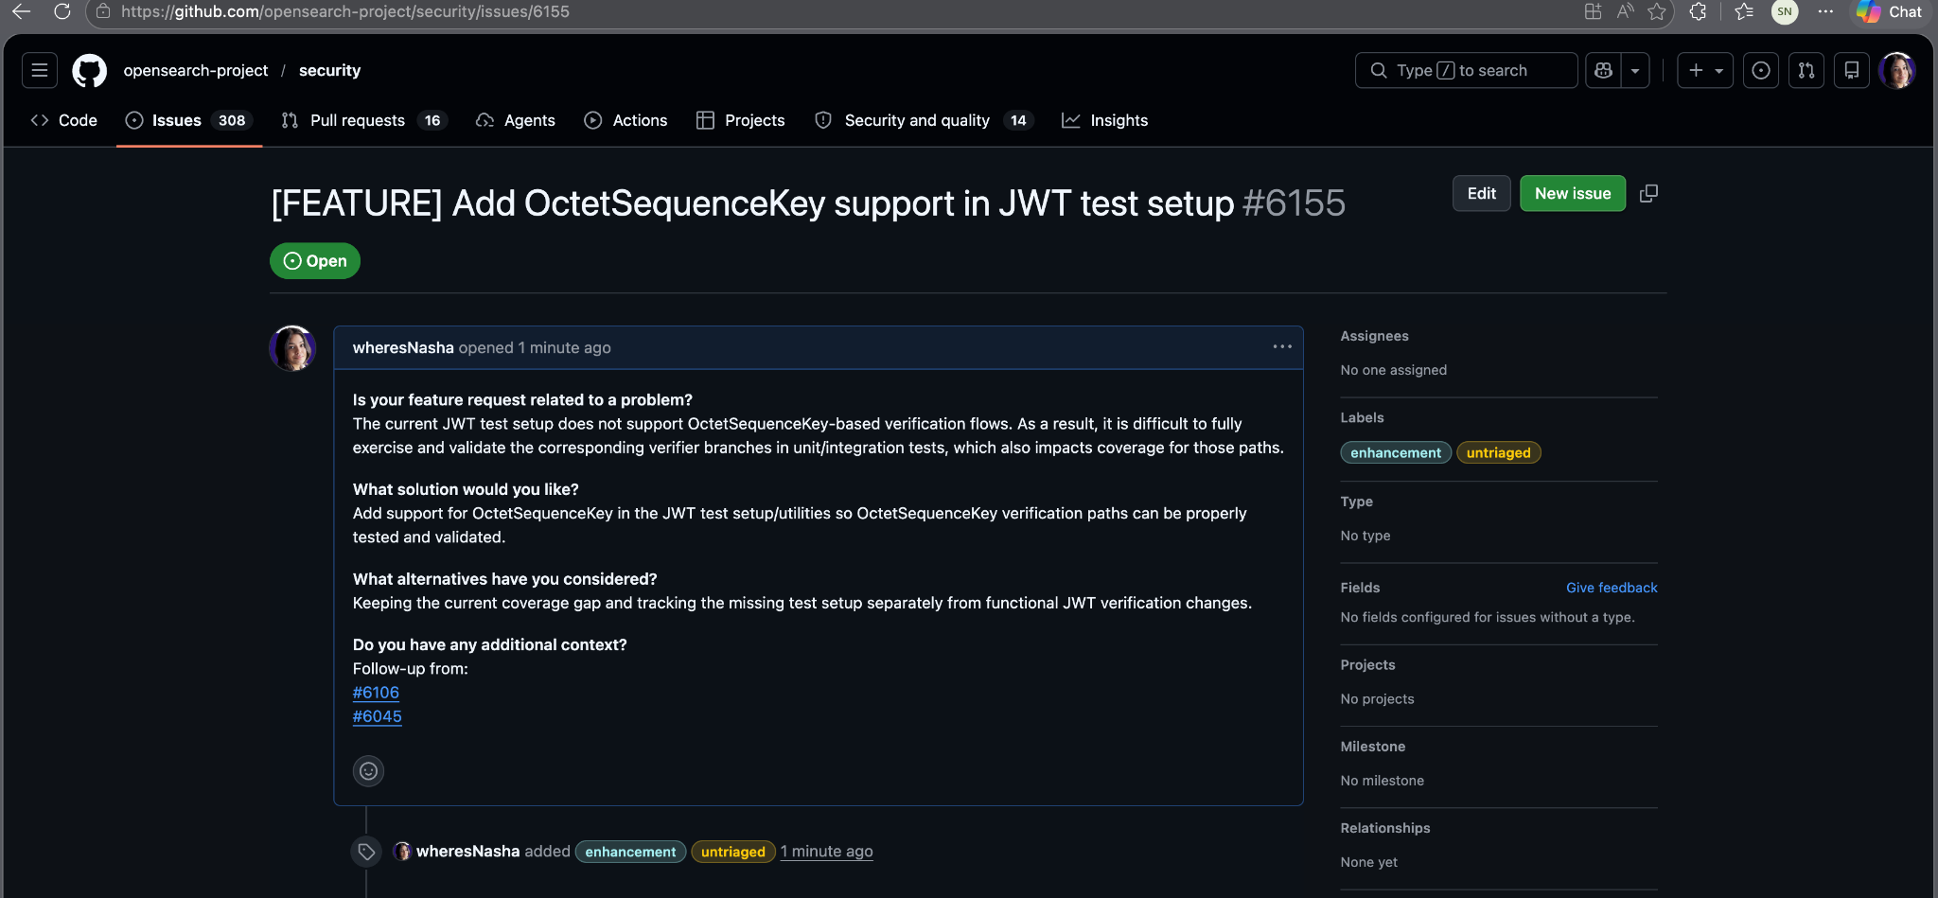

My First Issue Raised (Simple yet healthy)
Notes:
In the security repository, I fixed a bug on the auth layer to accept ECKey and while I was writing Unit test cases to test the behavior and the code coverage, I realized the OctetSequenceKey support exist, but the test setup misses that. I just created an Issue for the same. It took me just 2-4 mins to report an issue the template is already there and is pretty straightforward. Aim: We really want more people to play around our Product and report issues.

Slide 10
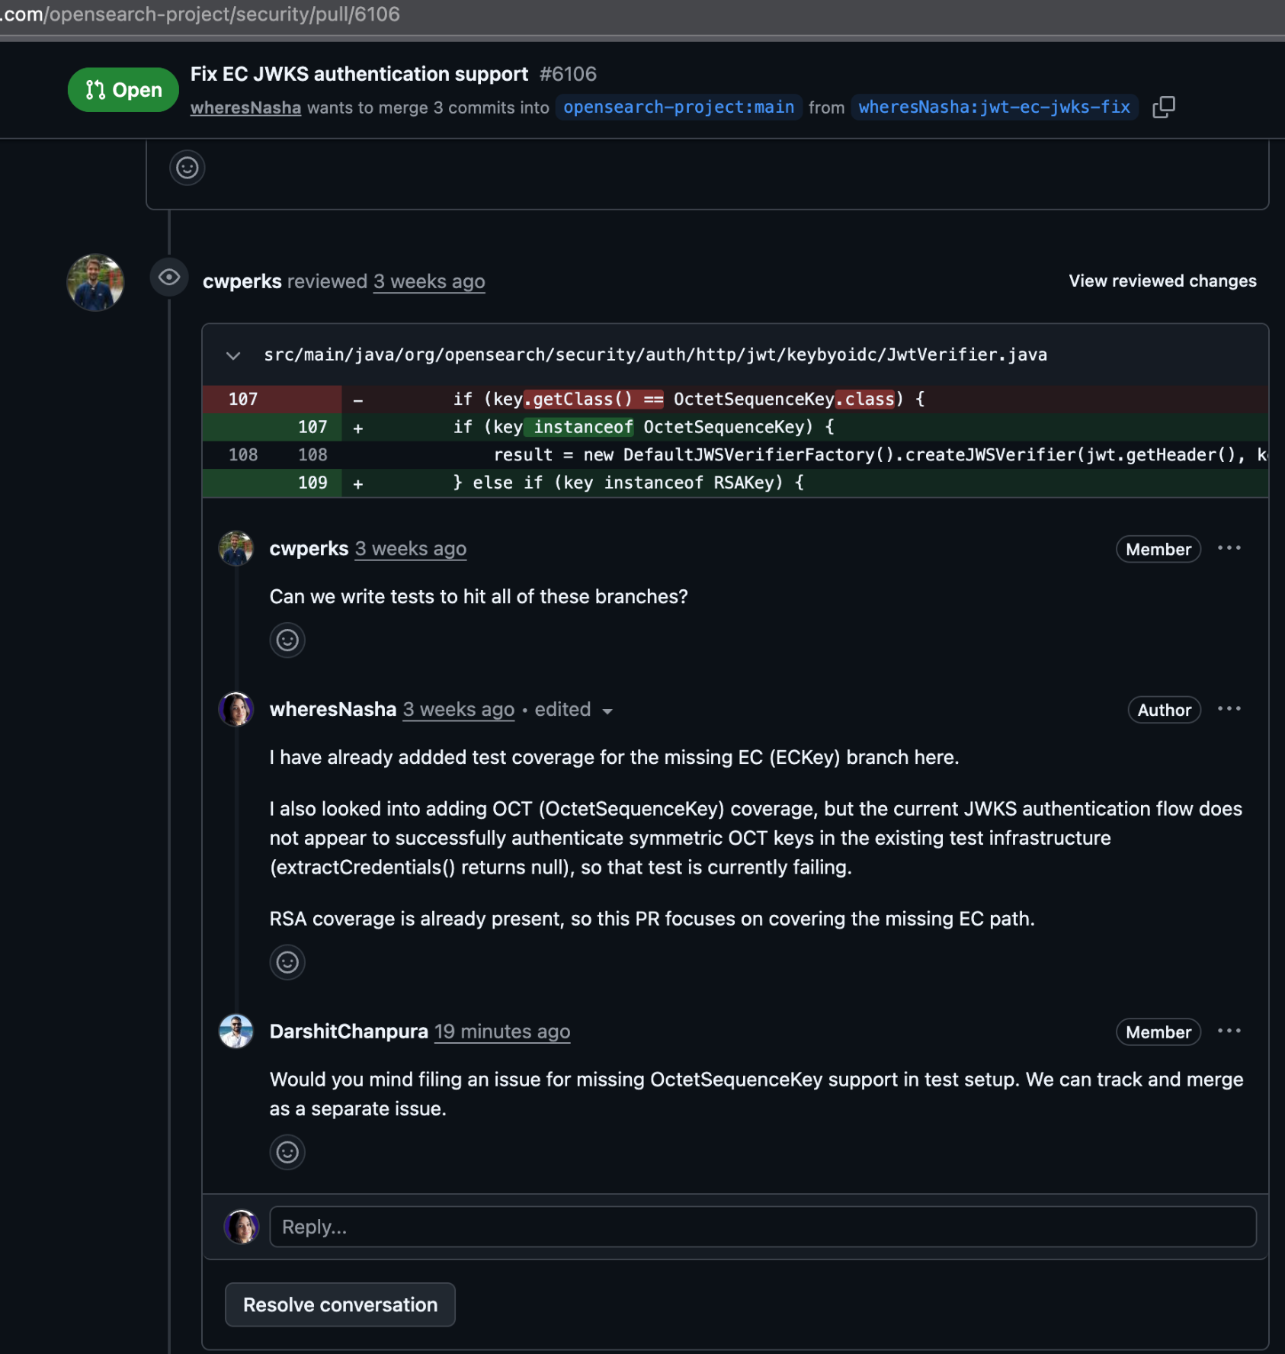

Putting out my thoughts
Notes:
What ever your thoughts are just put them out and interact with the maintainers and get to know the expectation out there.

Slide 11
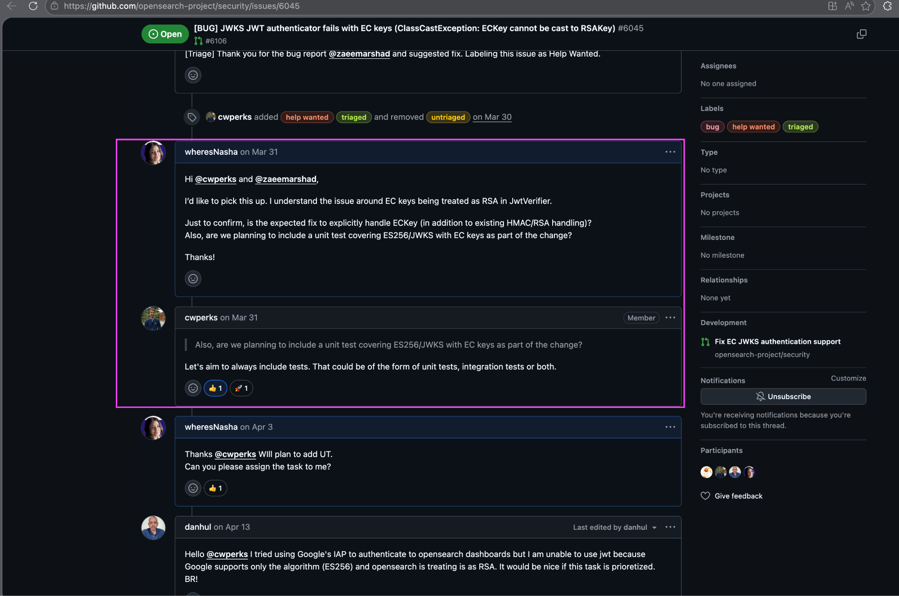
Putting out my thoughts
Notes:
That's a simple example of how you start picking up a bug: simply by adding a comment to let the maintainer and reporter of the issue know your thoughts, align with them and simple work on it

Slide 12
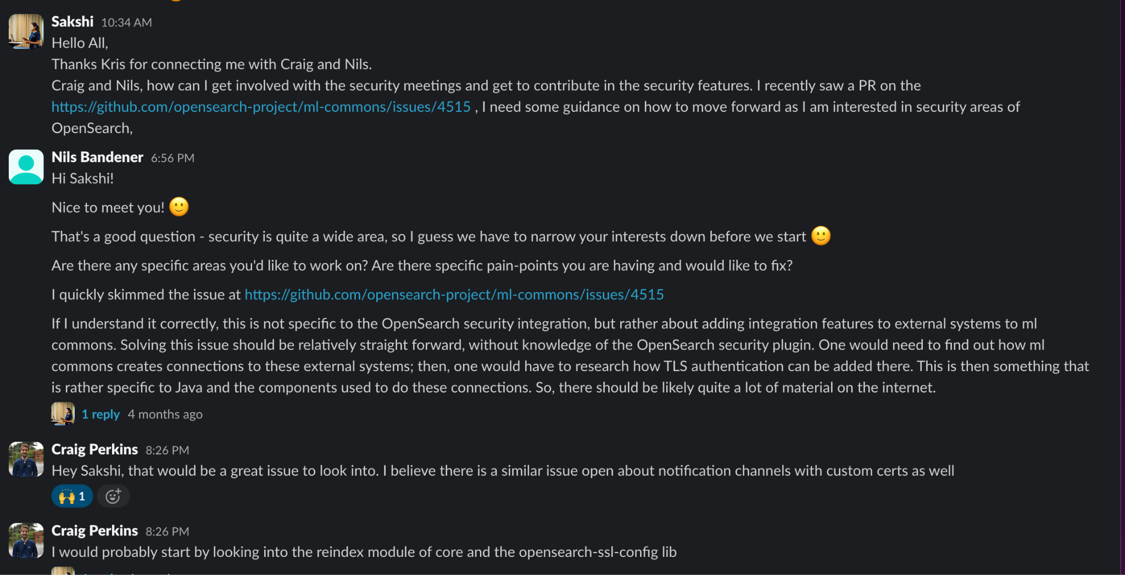
Asked out for help, even though sounding dumb
Notes:
It was back a year ago where I was so new into the Security repository and little did, I know how to pick bug, which ones should I pick? And so many unknowns Simple yet effective way is to start a conversation on slack and tell your interest. Get into the details, at first, you may sound silly but with time and practice it will get better. Everybody out there was once in your shoes too…

Slide 13
My Journey so far… miles to go !!
01
OpenSearch Ambassador
Playing with OpenSearch
05
02
Curiosity to Learn
Spread knowledge to the OpenSource Communtiy
Participated in the Forums
04
03
Asked Questions, Participated in Design Discussions
Notes:
To give you some context, I didn’t start out as some open-source expert. My journey began exactly where many of you might be right now—just playing around with OpenSearch, trying to understand how it worked. I vividly remember the intense 'first PR fear’ that anxiety of putting your work out there, learning in public, and having to ask the project maintainers for help.
But my core driver was simply a curiosity to learn. I pushed past that initial hesitation and moved from just playing with the technology to actively participating in public forums and jumping into technical design discussions. I started giving feedback and asking questions, and that non-code community engagement completely changed my trajectory.
It opened doors I didn't even know existed. It led to my very first international presentation at OpenSearch Europe 2025, and from there, things snowballed. I went on to become a panellist for major global events across North America, Japan, and now China in 2026.
All of that foundational, community-first work eventually culminated in me becoming an OpenSearch Ambassador. Today, this role gives me a direct channel to voice real user concerns and collaborate face-to-face with core maintainers to get things done.
The big takeaway from my story is that if you are sitting in the audience right now feeling intimidated by open source, don't be. Every single ambassador and maintainer started with that exact same first PR fear.

Slide 14

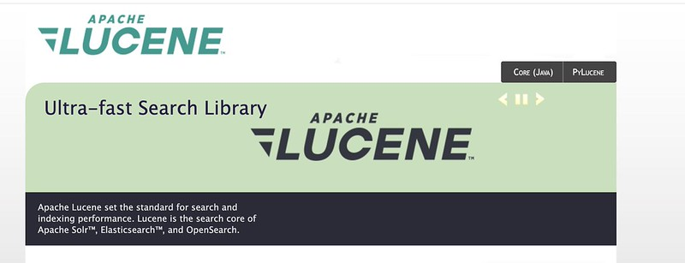
Small Contributions → Big Impact
Lucene website update
If you see something that you can update – do it!
Notes:
Sometimes there is a small change that can have a (hopefully) big impact
Like with a number of leading search tools - OpenSearch is, at it’s core, based on Apache Lucene. I was looking at the Lucene website and noticed the others listed, but not ours. I don’t really consider myself a developer, but I can go in and hack website code from time to time so I thought – hey – this is something simple that I know I can assist with. The Maintainer of this repository was appreciative, merged the code, and now OpenSearch is listed with the other leading search-based tools.

Slide 15
Small Contributions → Big Impact
Documentation, README.md, DEVELOPER_GUIDE.md & more
Notes:
“Maintainers lose hours on missing context. -- One paragraph of documentation can save hundreds of users.” what this means is, if you are using an open source software package and find an area where you got stuck – chances are others got stuck as well. Document that,
Other examples: typo fix
startup.md improvement
sample config
reproducing bug
adding screenshots
testing on another platform

Slide 16
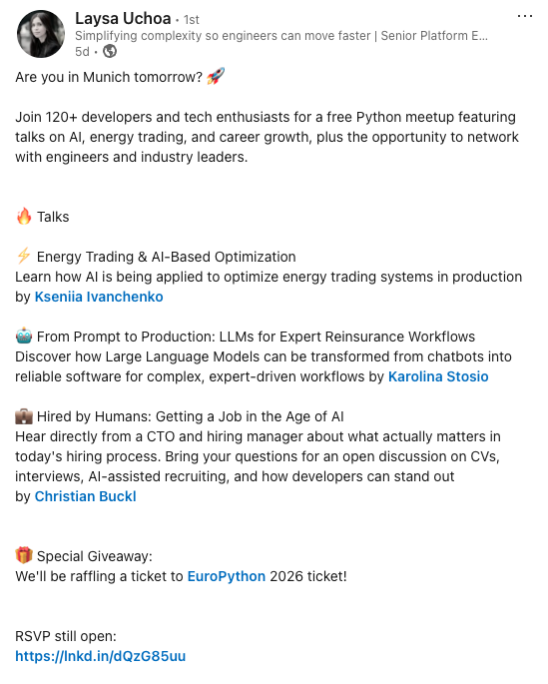
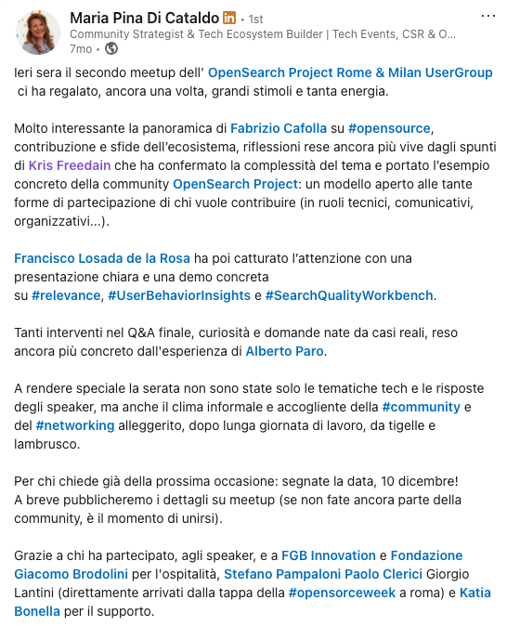
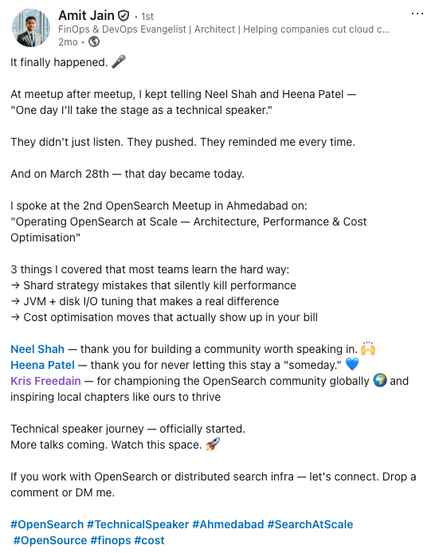
Small Contributions → Big Impact
Social media and sharing with your community
Notes:
Social from a project or corporate channel is useful, but hearing from your colleagues and those that you trust is something even better
My friend Laysa is very involved with PyLadies Munich and this was a post about an upcoming meeting, inviting her network to RSVP
One of our user group organizers, my friend Maria Pina posted a great summary of a meeting where we got to come together in Milan Italy
And this last one is one of my favorite posts yet – Amit came to an OpenSearch User Group and accomplished a goal – his first technical presentation! As the community manager for this project this one brought so much joy!

Slide 17
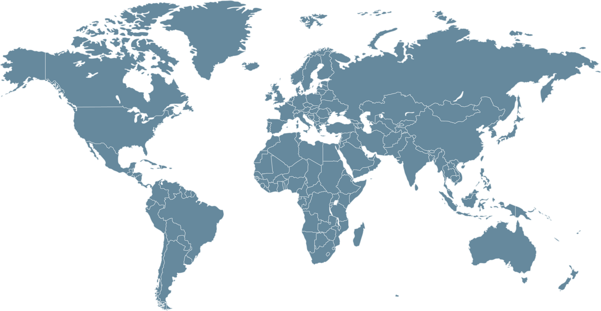
39 User Groups in 21 Countries
opensearch.org/user-groups
Amsterdam
London
Berlin
Vancouver
Bristol
Chicago
Vienna
Seattle
New York
Karlsruhe/Pforzheim
Seoul
Dublin
Tel Aviv-Yafo
Austin
Boston
Lisbon
Munich
Delhi
Bay Area
Paris
Ahmedabad
Jaipur
Milan
Cairo
Tokyo
Rome
Pune
Hyderabad
Dubai
Bangkok
Coimbatore
Bengaluru
Singapore
Chennai
São Paulo
Cape Town
Sydney
Melbourne
Notes:
Here are the locations of our global user groups. Nearly all of them have held more than one meeting which speaks to the commitment level of our solution provider network, who are often the ones sponsoring and organizing these meetings.

Slide 18
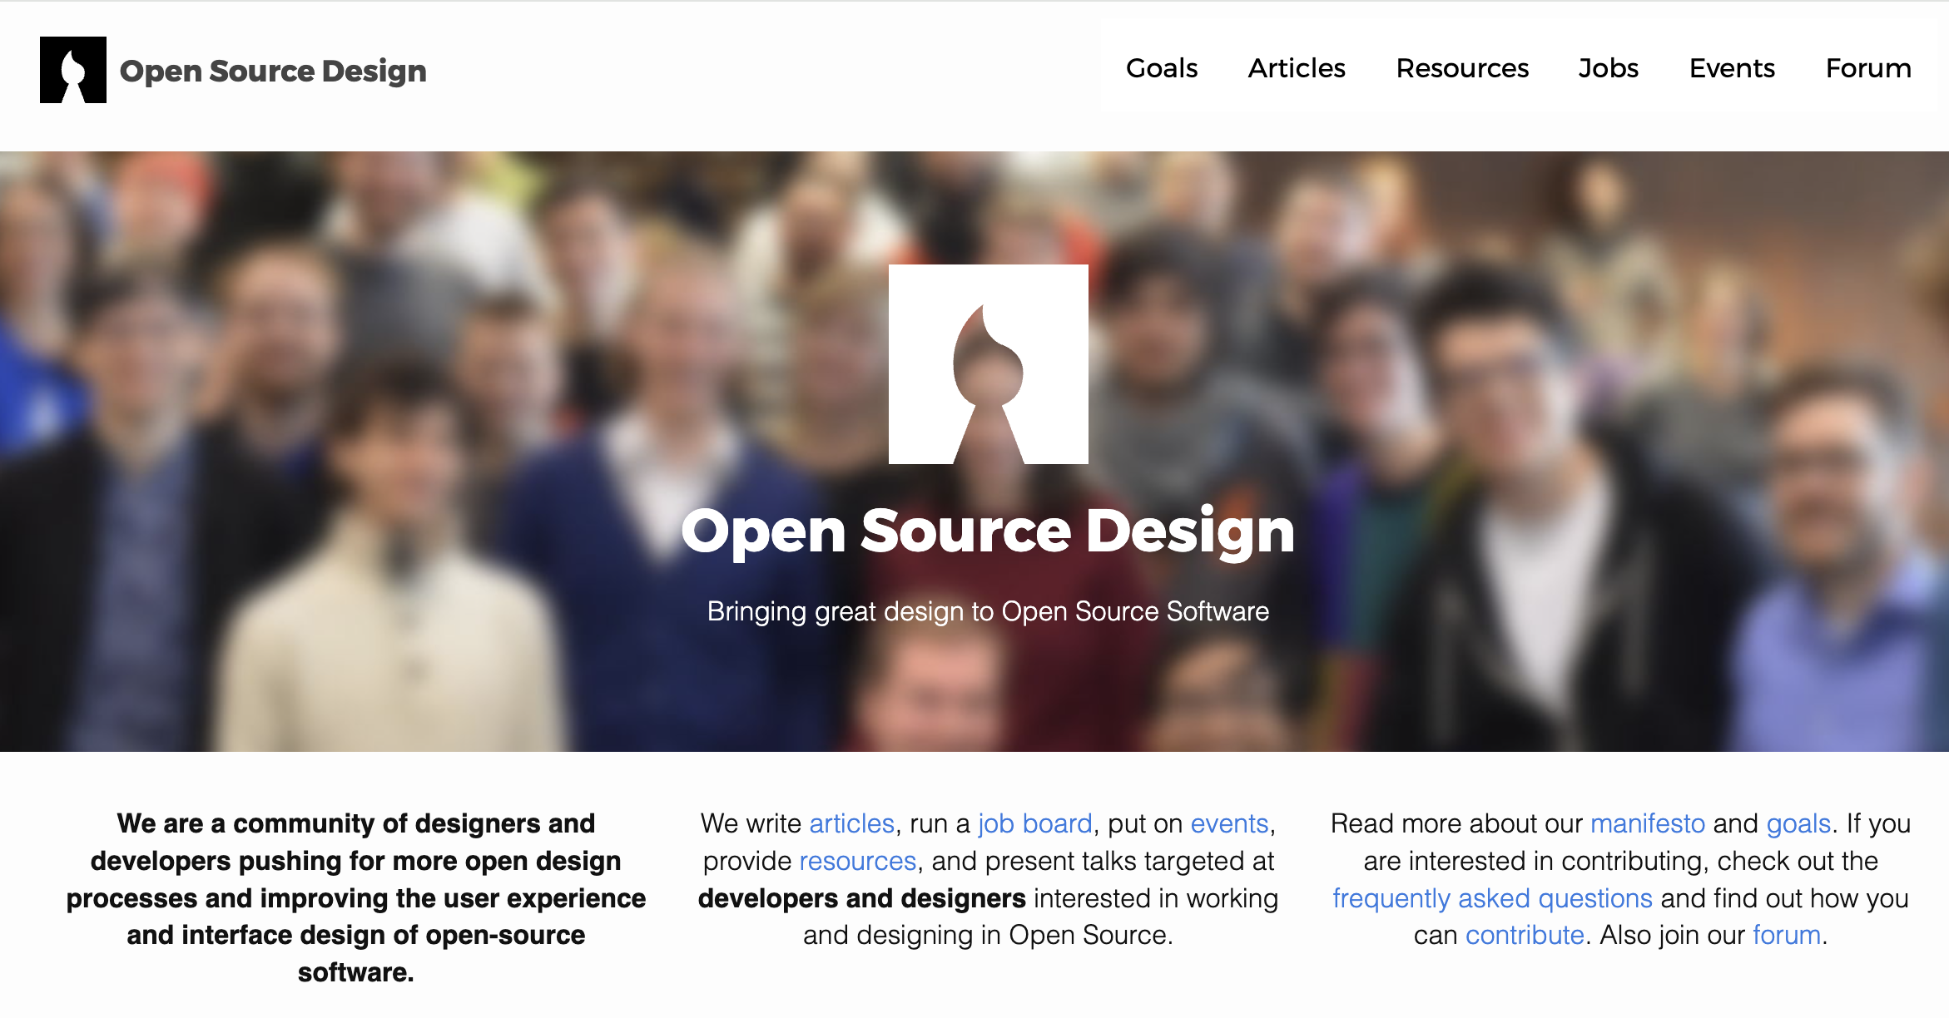

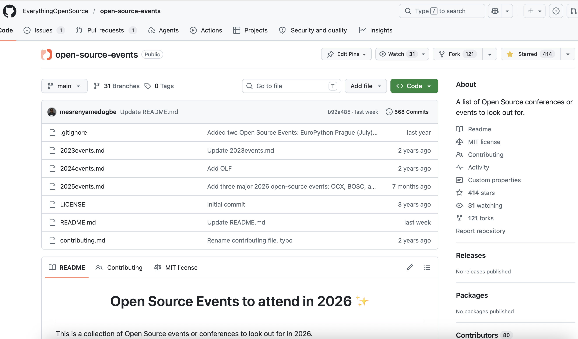

Look for what interests you
Notes:
Find a community that interests you. There are so many in the open source world
Design? My friend Eriol is involved with Open Source Design
Events? My friend Abigail maintains a community-driven repo of open source events around the world
Metrics? Friends like Dawn over at the CHAOSS community (which also runs OpenSearch)
Python learning or coding? There is an amazing global org of ladies that help one another along their path in the python community

Slide 19
Small Contributions → Big Impact
Lucene PR fix by Kris Other examples: typo fix
startup.md improvement
sample config
reproducing bug
adding screenshots
testing on another platform
Notes:
“Maintainers lose hours on missing context.
One paragraph of documentation can save hundreds of users.”

Slide 20
Ways to join the community
The Search Party
Dev Triage & TAG Meetings
Blogging & Social
Forum & Slack
Document how to get involved
User Groups & Conferences
Practical involvement in community and recommendations

Slide 21

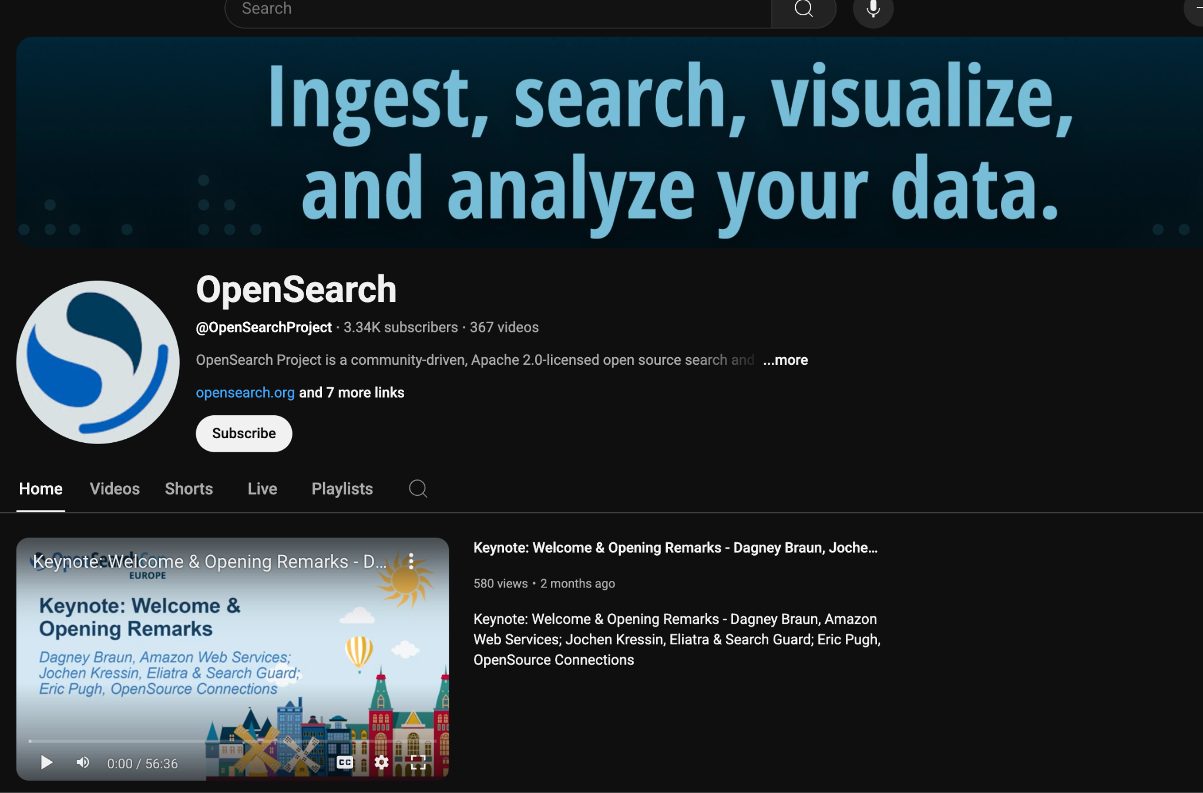
Connect with the OpenSearch Community
Forums, Slack, Triage meetings
UserGroups and Events
Maintainers
▶️ YouTube
🧑‍💼 LinkedIn
OpenSearchCon
Ask questions, get guidance

Slide 22






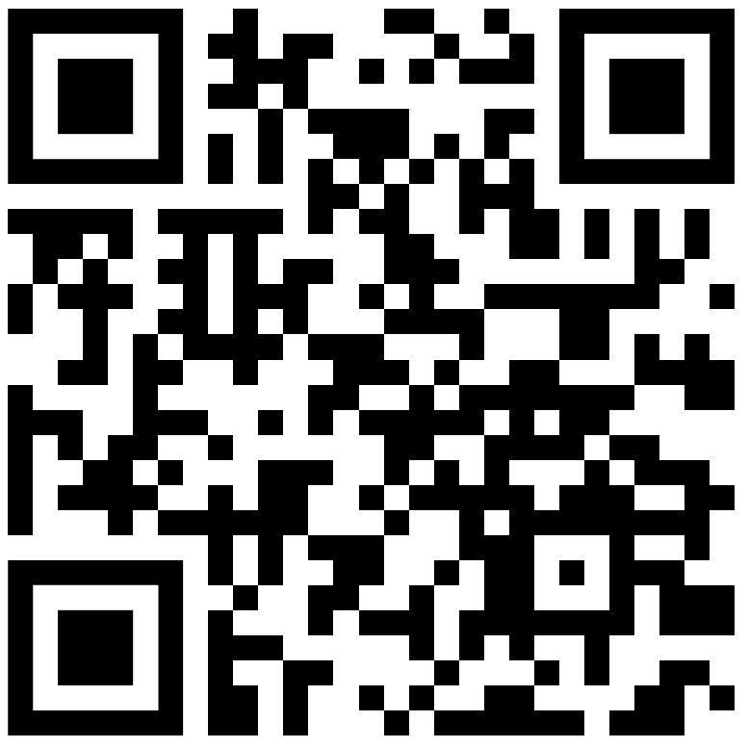
Join the conversation
User Groups
Forum
Events
Blog
GitHub
Slack

Slide 23
Thank you!
Our photo together that we click @OS India
See you in the OpenSearch community!

Slide 24
Community Contributions are increasing
Year in review: Community momentum since OpenSearchCon Europe in May 2024
6
3
9
28%
1,500+
new releases on the 2.x line
new releases on the 3.x line
new user groups launched
year-over-year increase in project downloads
new OpenSearch Forum members
1,700+
225+
13,000
25%
new OpenSearch Community Slack members
organizations contributed to the codebase
total contributions from the community
increase in web site traffic
Notes:
Here’s a snapshot of the 12 months leading up to today (May 2025). We’ve seen consistent growth across a broad range of categories including developer meetups, year-over-year downloads, collaboration avenues and contributing organizations. One of the callouts here that impressed me was that over 225 different companies have made contributions to this project. This is not common in the open source world. The acceleration in downloads also exceeded our expectations especially in the last 7 months, a pretty specific time frame.

Slide 25
How Maintainers Can Enable Contributors
Kris Topics:
labeling issues
mentorship
onboarding docs
response etiquette
inclusive reviews
contribution pathways
Notes:
Slide to be considered for Apache 40 min talk
“Maintainers lose hours on missing context.
One paragraph of documentation can save hundreds of users.”

Slide 26
Sustainability in Open Search Ecosystem
Kris
Notes:
Slide to be considered for Apache 40 min talk

Slide 27
Contributions!
How have people contributed so far?
Notes:
Slide to be considered for Apache 40 min talk

Slide 28
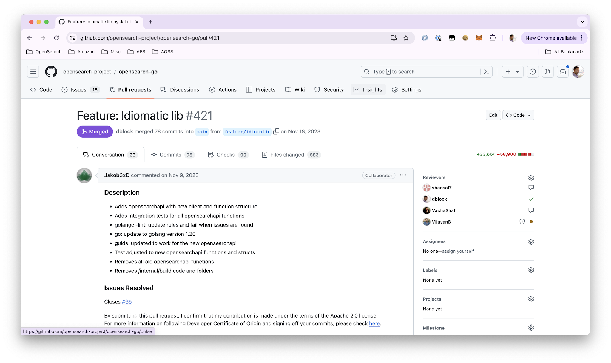
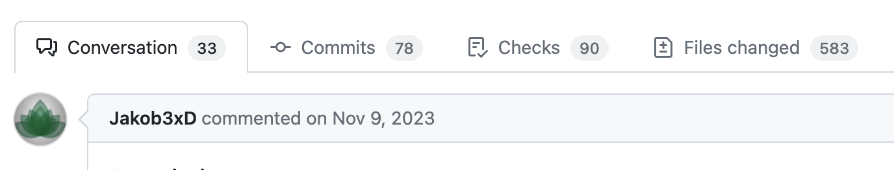
Rewrite a section of the project! opensearch-go#421
Notes:
This person started patching the Go client.
As time went on, they ended up rewriting it
Yes – this person is now a MAINTAINER on the project as well (of course! They know this client better than anyone)

Slide 29
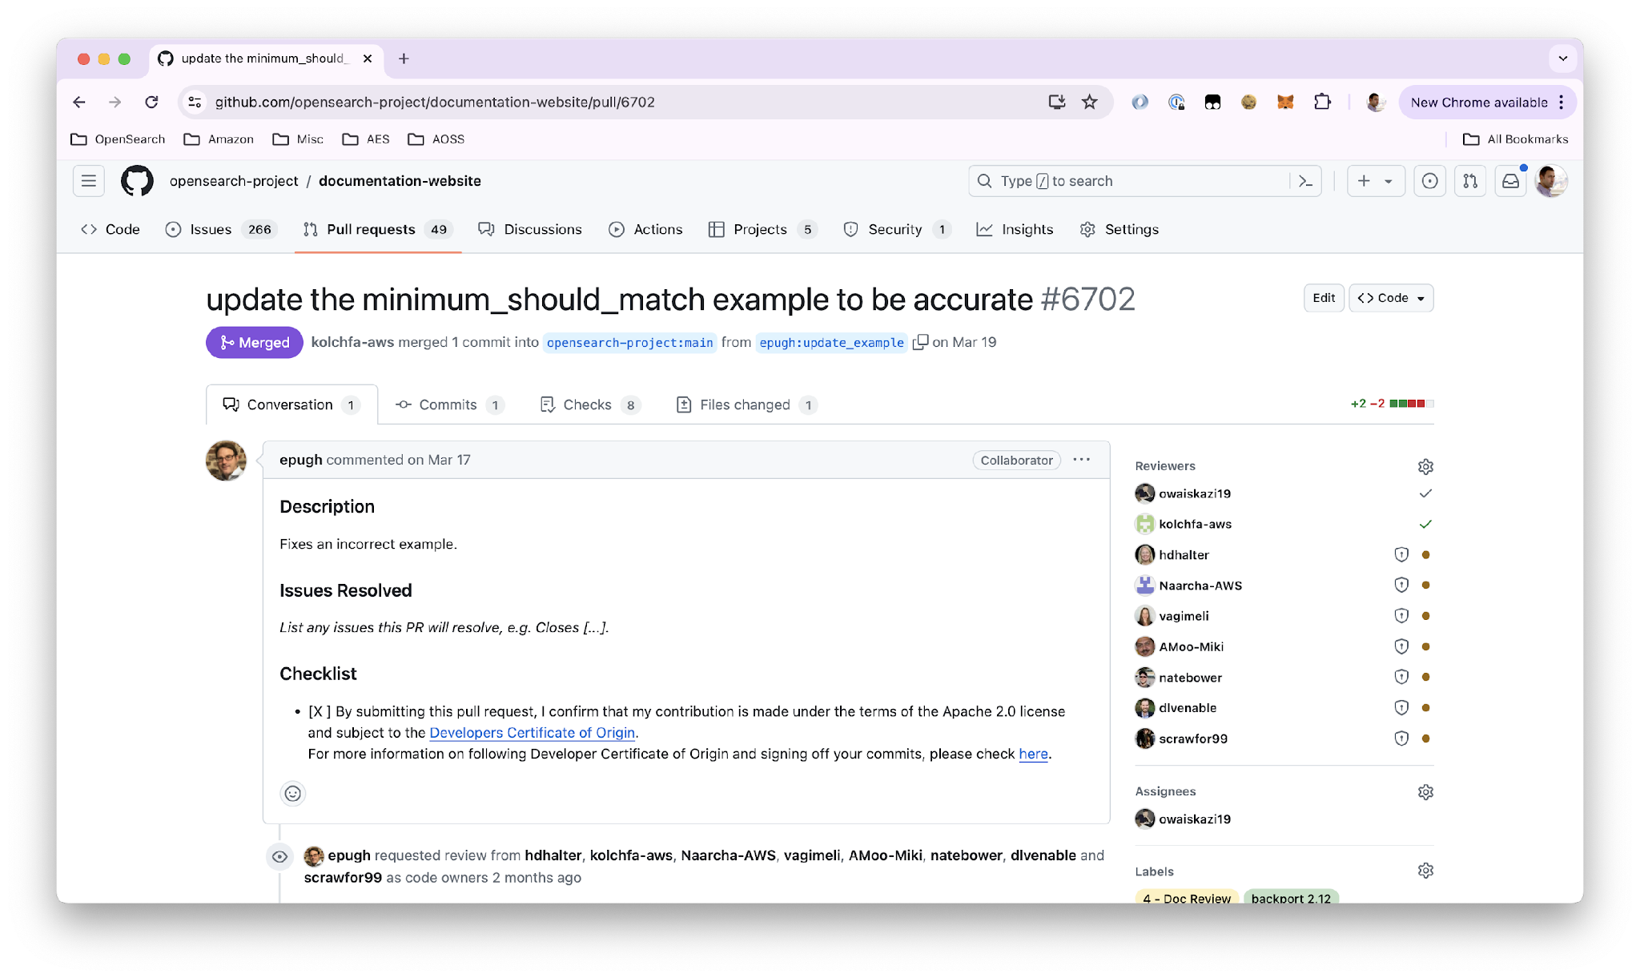
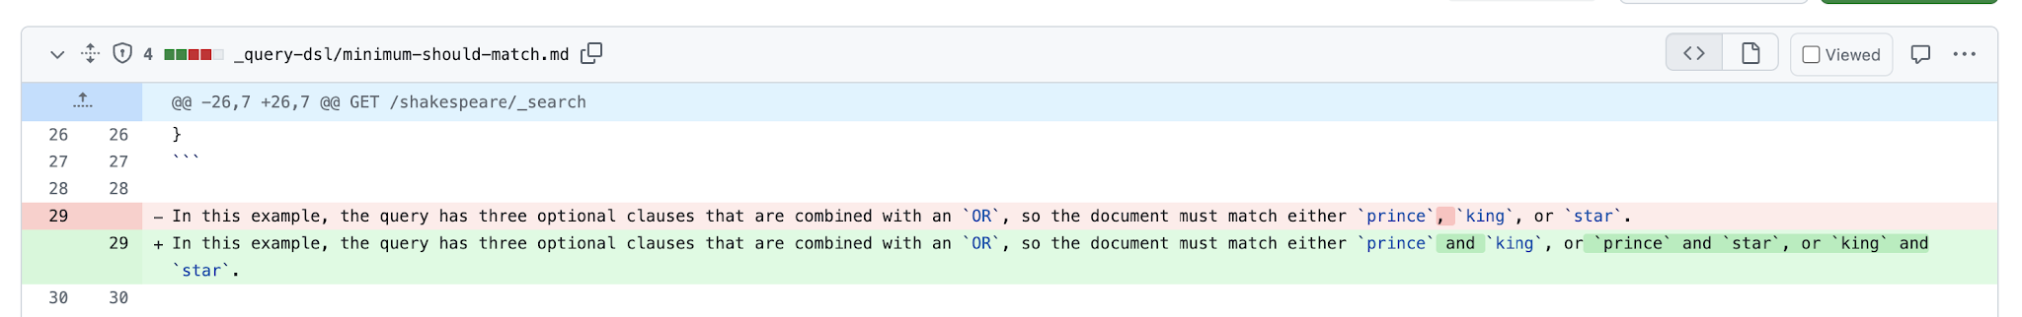
Documentation documentation-website#6702
Notes:
See something inaccurate in the documentation? Help the community fix it.
This is an area we’re always looking for help – your contributions will go very far
This has the potential to help a very large number of people

Slide 30
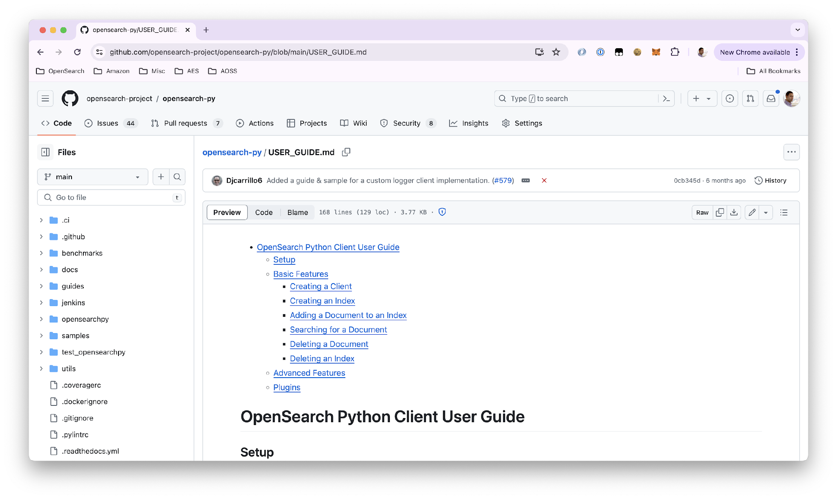
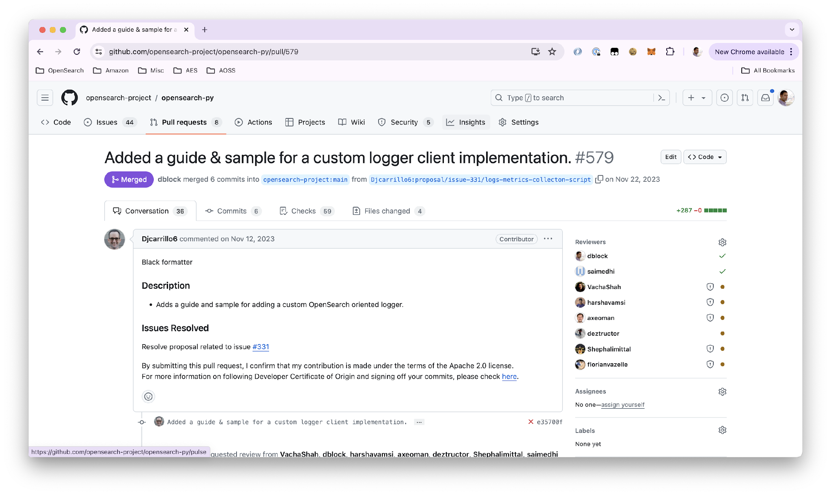
USER_GUIDE + Samples
Notes:
Another excellent place some have contributed are the User Guides or Samples.
User guides assist others in the ’how to’ of a section of the project – and Samples are just that – code samples that run for a specific use case.

Slide 31
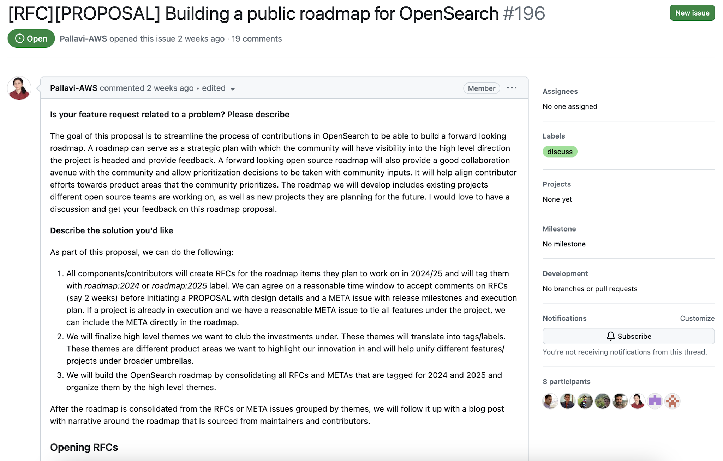
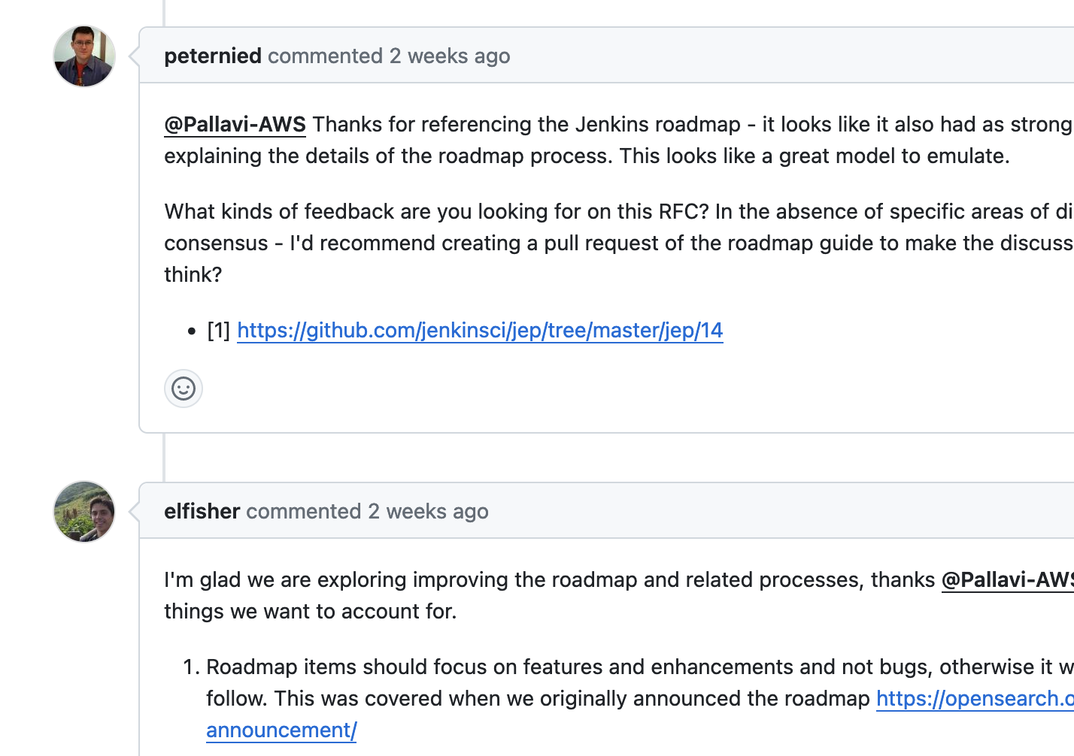
RFC
Notes:
RFC = Request for comments
Have a idea for a new feature? A new way to do things with the project? Something you would like to see the software do? Submit an RFC and build out ideas with the community

Slide 32
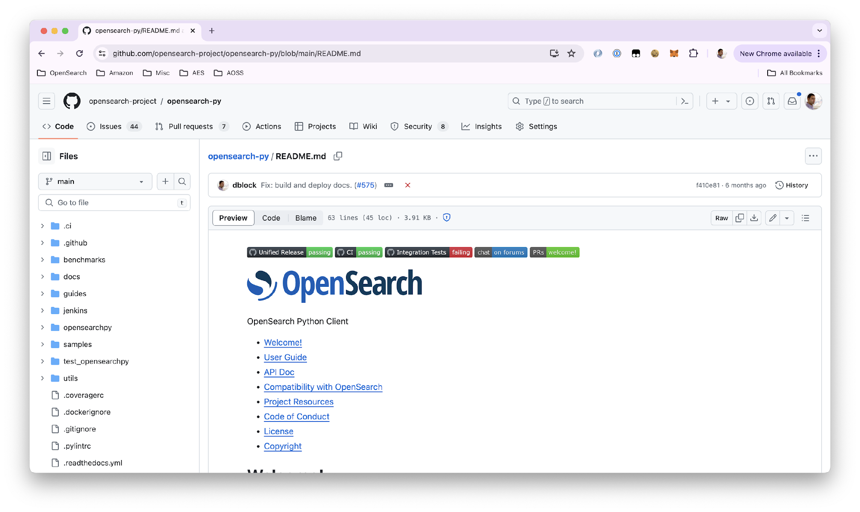
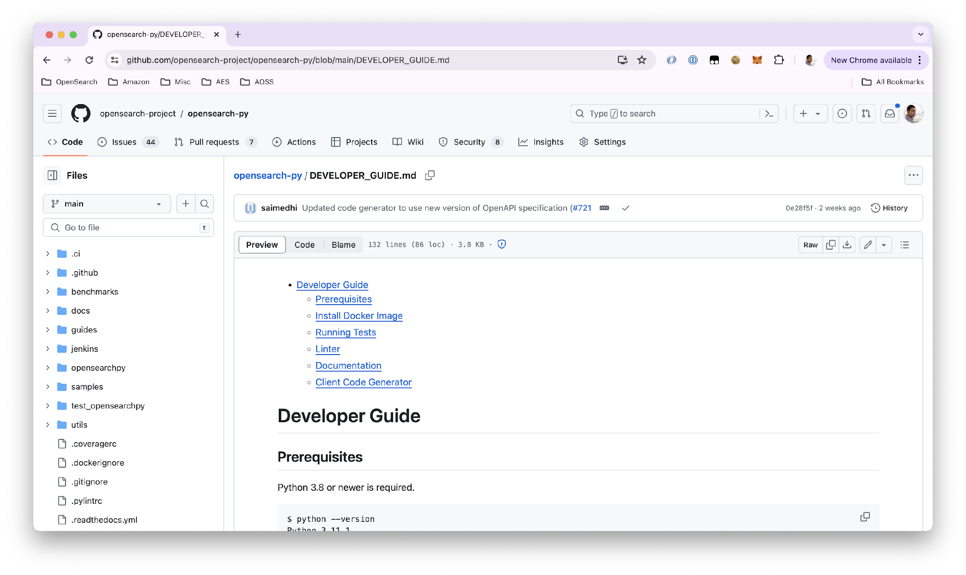
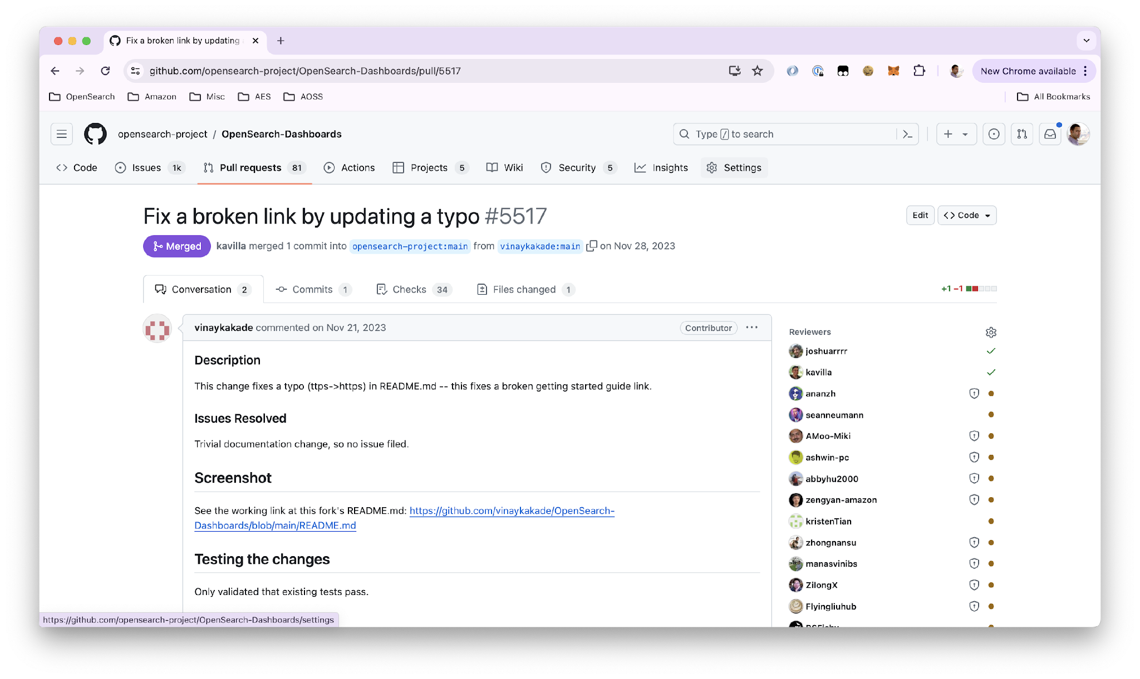
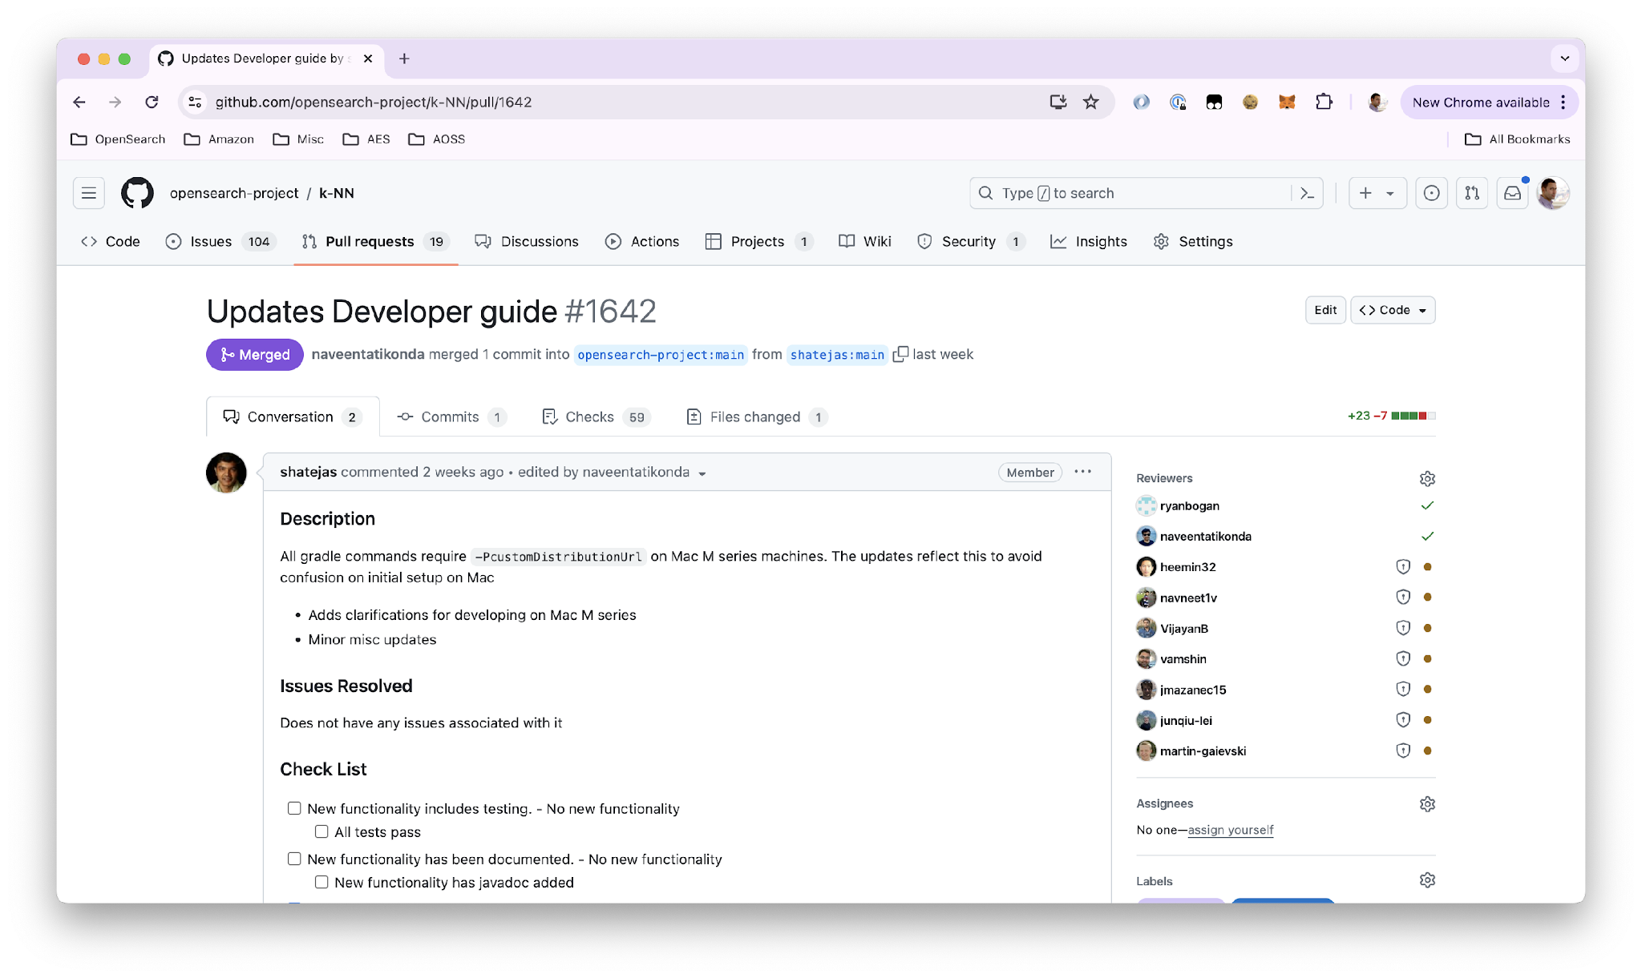
README.md, DEVELOPER_GUIDE.md
Notes:
Every repo has a README. Spot a typo in the README, this could be your first PR.
There is also a developer guide in the .github repo – someone noticed there was missing information that impeded them – they figured out the missing steps and contribute back to the file – another way to help a large number of others

Slide 33
Good first issues – Org level
Filter issues on Github by tag good first issues
Maintainers of each repo mark things for new contributors (or ‘Help Wanted’)
Across the entire org: https://github.com/search?q=org%3Aopensearch-project%20is%3Aissue%20is%3Aopen%20label%3A%22good%20first%20issue%22%20&type=issues
Notes:
Slide to be considered for Apache 40 min talk

